Slide 1
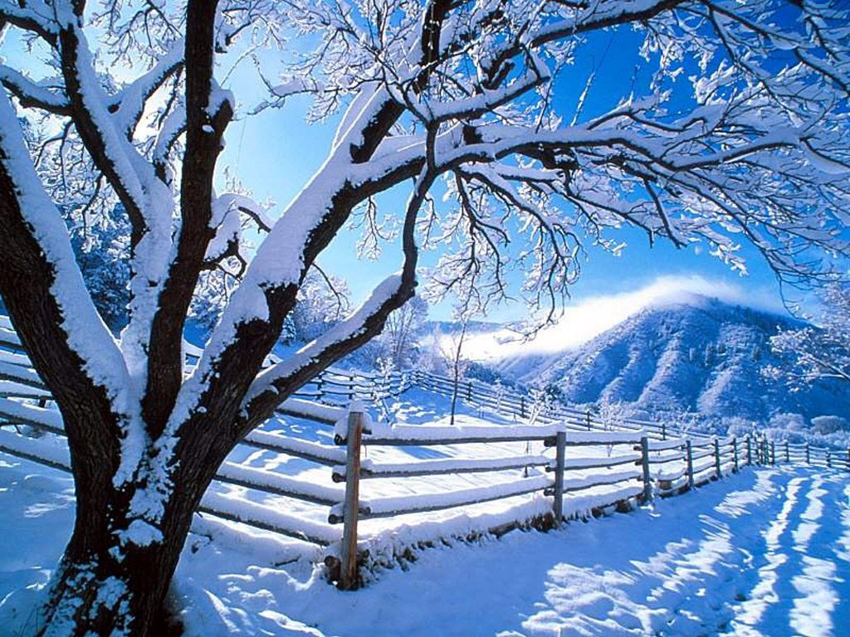
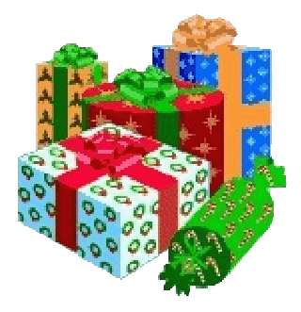
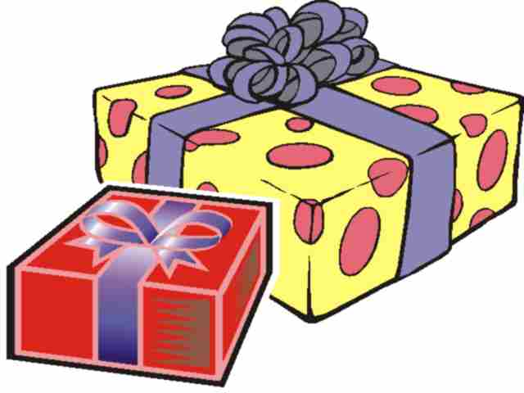
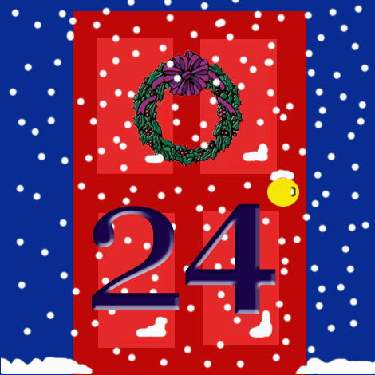
When are presents opened in Germany?
a. Christmas Eve
b. Christmas Day
c. Boxing Day

Slide 2

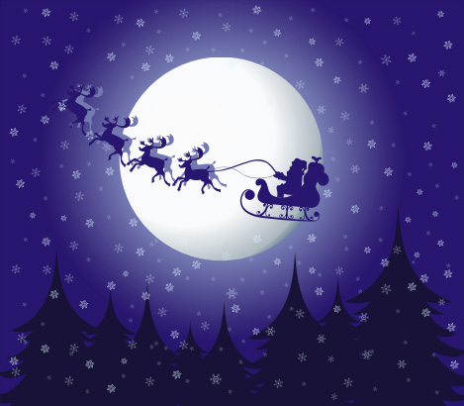
When are presents opened in Germany?
German children open their presents on Christmas Eve. They often go to church, then have a meal with their family and then open presents.

Slide 3
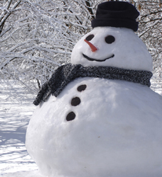
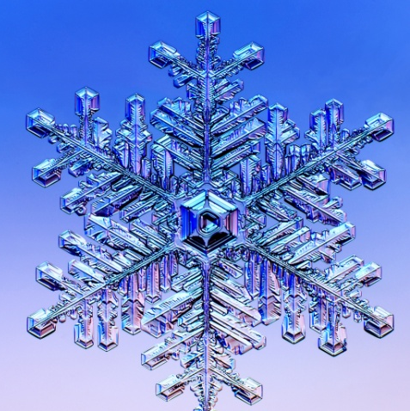
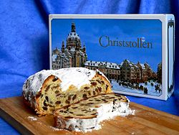
What is Stollen?
a. A Christmas decoration
b. A special cake
c. A Christmas drink

Slide 4
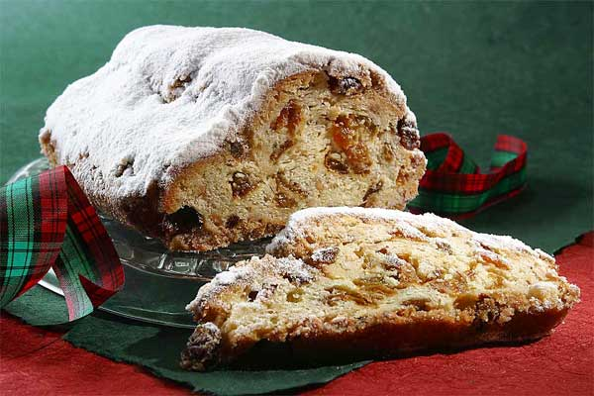
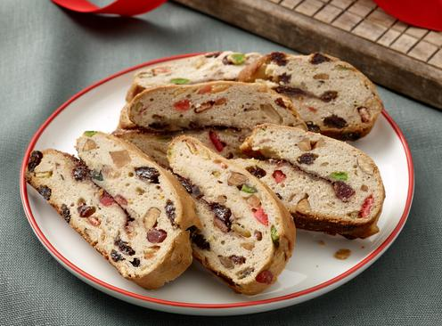
What is
Stollen?
Stollen is a special cake that is eaten at Christmas.It has lots of dried fruit in it and marzipan. It was first made in 1427.

Slide 5
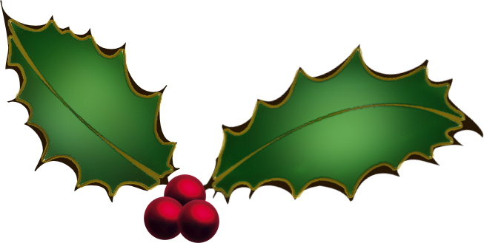
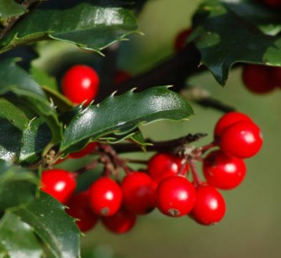
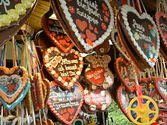
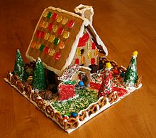
What are Lebkuchen?
a. Gingerbread
b. Christmas carols
c. Christmas drinks

Slide 6
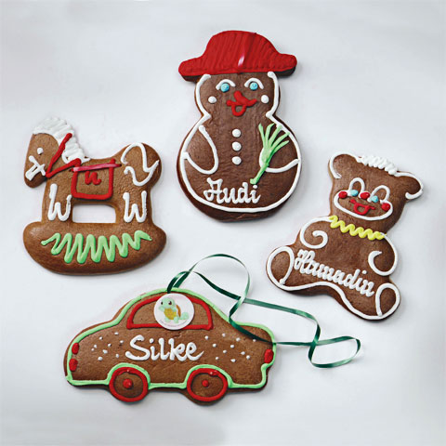
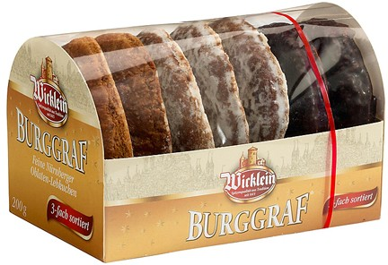
What are
Lebkuchen?
Lebkuchen are a type of gingerbread, but with some extra spices in. They are sold as biscuits, hearts and houses.

Slide 7
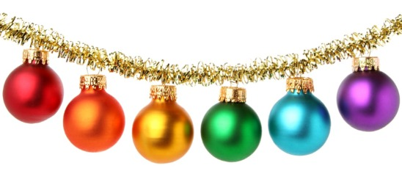
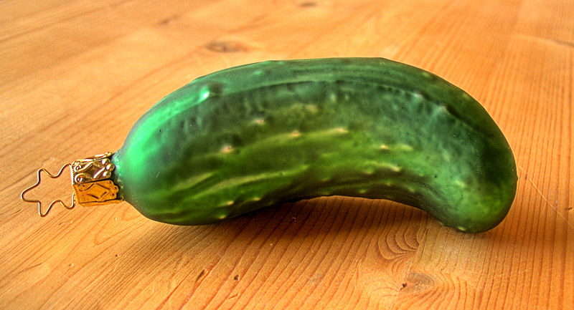
Which food item can you find on some German Christmas Trees?
a. Lettuce
b. A tomato
c. A pickle

Slide 8
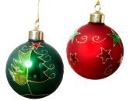
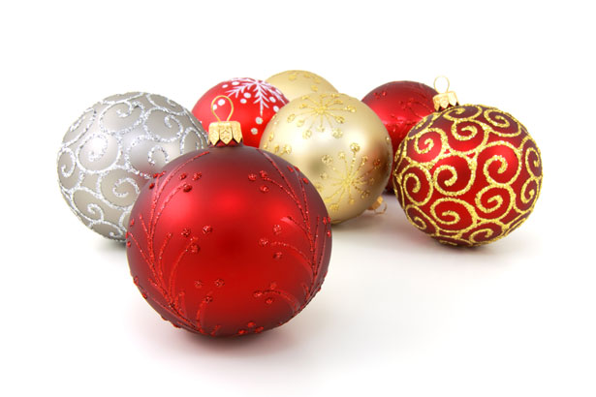
Which food item can you often find on German Christmas Trees?
This is also a tradition in America. If you manage to find the gherkin (the pickled cucumber) on the tree, you can open your presents first.

Slide 9
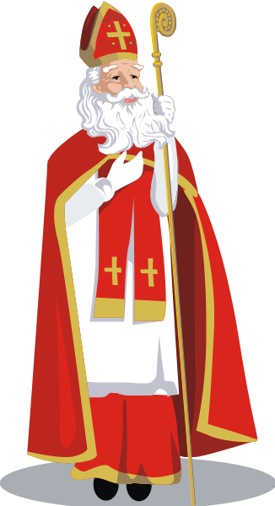
When is Nikolaustag?
a. December 1st
b. December 6th
c. January 6th

Slide 10
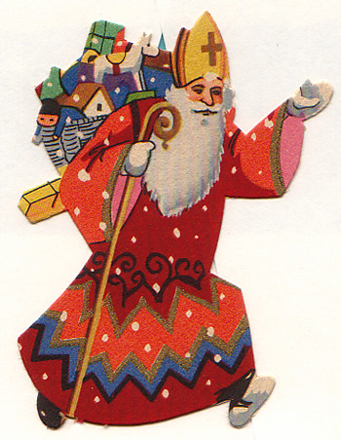
When is Nikolaustag?
Nikolaustag, or St. Nicholas Day, is on the 6th of December. Children leave their shoes out the night before and when they wake up, St. Nicholas has filled them with sweets and gifts.

Slide 11
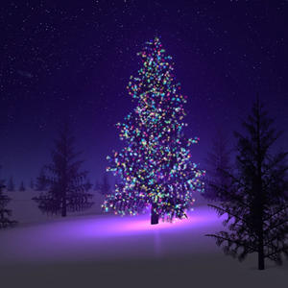
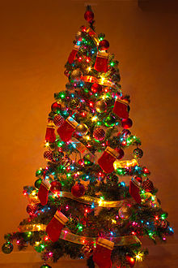
What day do most German families put up their Christmas tree?
a. December 1st
b. December 6th
c. December 24th

Slide 12
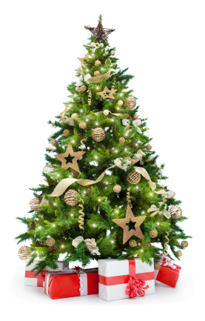
What day do most German families put up their Christmas tree?
Most families decorate their trees on Christmas Eve. They then put all of the presents under it. Some families even cut their own tree down from woods near where they live.

Slide 13
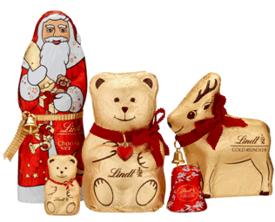
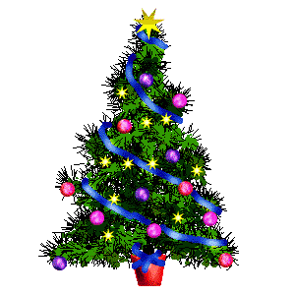
Which Christmas tradition originally started in Germany?
a. Christmas Carolling
b. Elf on a Shelf
c. The Christmas Tree

Slide 14
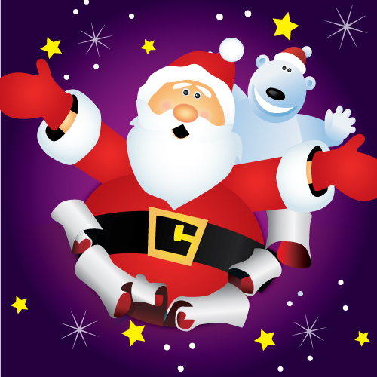
Which Christmas tradition originally started in Germany?
The Christmas tree comes from Germany. Children are not involved in decorating the tree. It is believed that the tree has some mysterious spell for all young eyes that rest on it before Christmas Eve, so the parents decorate the tree in secret.

Slide 15
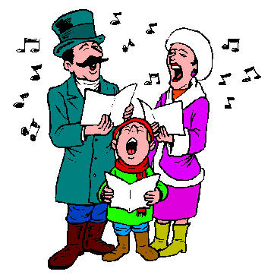

Which country was “Silent Night” originally written in?
a. Switzerland
b. Germany
c. Austria

Slide 16
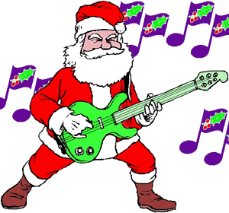
Which country was “Silent Night” originally written in?
"Silent Night" or “Stille Nacht“ was composed in Austria in 1818. In 2011, it was declared as an intangible cultural heritage by UNESCO.

Slide 17
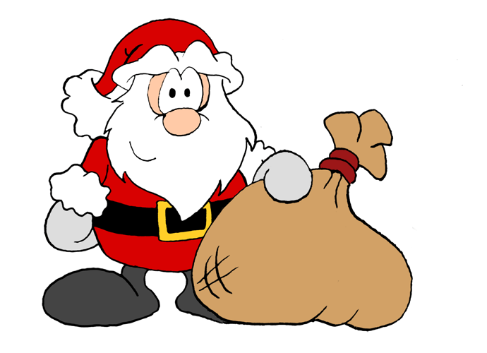
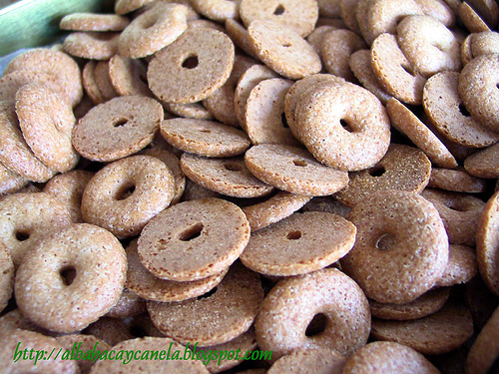
What are “Ringli”?
a. Swiss Doughnuts
b. German Songs
c. Austrian Instruments

Slide 18
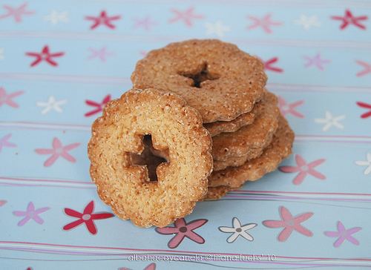
What are “Ringli”?
“Ringli” are a type of doughnut or biscuit that are eaten in Switzerland on Christmas Eve before opening presents. They are normally eaten with hot chocolate.

Slide 19
Who is Weihnachtsmann?
A. Superman
B. A Christmas Devil
C. Santa Claus

Slide 20
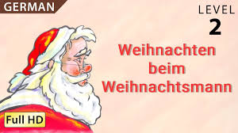
Who is Weihnachtsmann?
“Christmas Man,” or Santa Claus brings presents on
Christmas Eve.
“Christmas Man,” or Santa Claus brings presents on Christmas Eve.

Slide 21
Who is “Krampus”?
A. Santa’s Elf
B. A Christmas Angel
C. A Christmas Devil

Slide 22
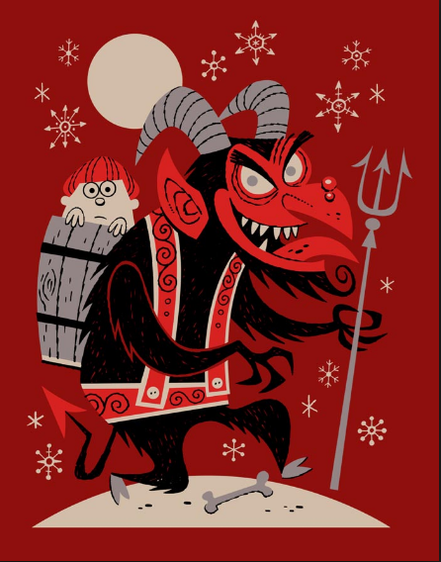
Who is “Krampus”?
Krampus is a folklore figure who scares children into being nice (instead of naughty).

